Slide 1
Marketing Quick Start Guide
Introduction to Marketing Resources & Support
Updated: November 2018

Slide 2
Redevelopment Unit Turns: Marketing & Redevelopment
Marketing works in partnership with Redevelopment to showcase community upgrades, enhance resident communications, drive occupancy, and boost online reputation
Marketing can assist with temporary signage, communication, photography, and other redevelopment support
Visit the Redevelopment Marketing Resources page on Buzz for a portfolio of marketing resources to assist you during redevelopment
Contact Marketing@essex.com for additional support

Slide 3
Redevelopment Unit Turns: Communication Plan
Whether your community is undergoing an interior unit turn, amenity upgrade, or a full renovation, clear communication to residents and prospects is key to a successful project
Renovation Communication Plans are available on Buzz
Operational Services → Marketing → Onsite/Community Resources → Redevelopment Marketing Resources
These marketing resources serve to assist you in communicating with your residents through all renovations:
Interior Unit Turns
Amenity or Exterior
Full Scope: Interior Unit, Exterior, and Amenities

Slide 4
Redevelopment Unit Turns: Advertising Menu
Available Advertising Options: | Execution & Notes:
Model Out of the Box | Contact your Project Manager if you need to order a new kit
Audio Visual Technologies – Photography, Virtual Tours, Virtual Staging, and Video Loops | Email Marketing@essex.com as soon as you have a mock-up unit ready. Allow up to two weeks for coordination
Collateral – Stationery | Flyers, Letterhead, Thank You Gift Card Sleeves. Available on The Home Store
Collateral – Temporary Signage | Wayfinding Maps, A-Frames, Bandits, Banners, Posters. Available on The Home Store
Resident Events – Open Houses | Open Houses are a great tool to advertise your renovation
Website – Content Update | Send details regarding the scope of your project to Marketing@essex.com to have your renovations featured on the website

Slide 5
Redevelopment Unit Turns: Model Out of the Box
Follow the below steps to order your Model Out of the Box kit:
CM confirms budget allowance with Project Manager
CM to complete Kupec Design order form
CM to provide Project Manager with total budget request
Project Manager will provide CM a PO#
CM will submit order form to Kupecdesign@pacbell.net

Slide 6
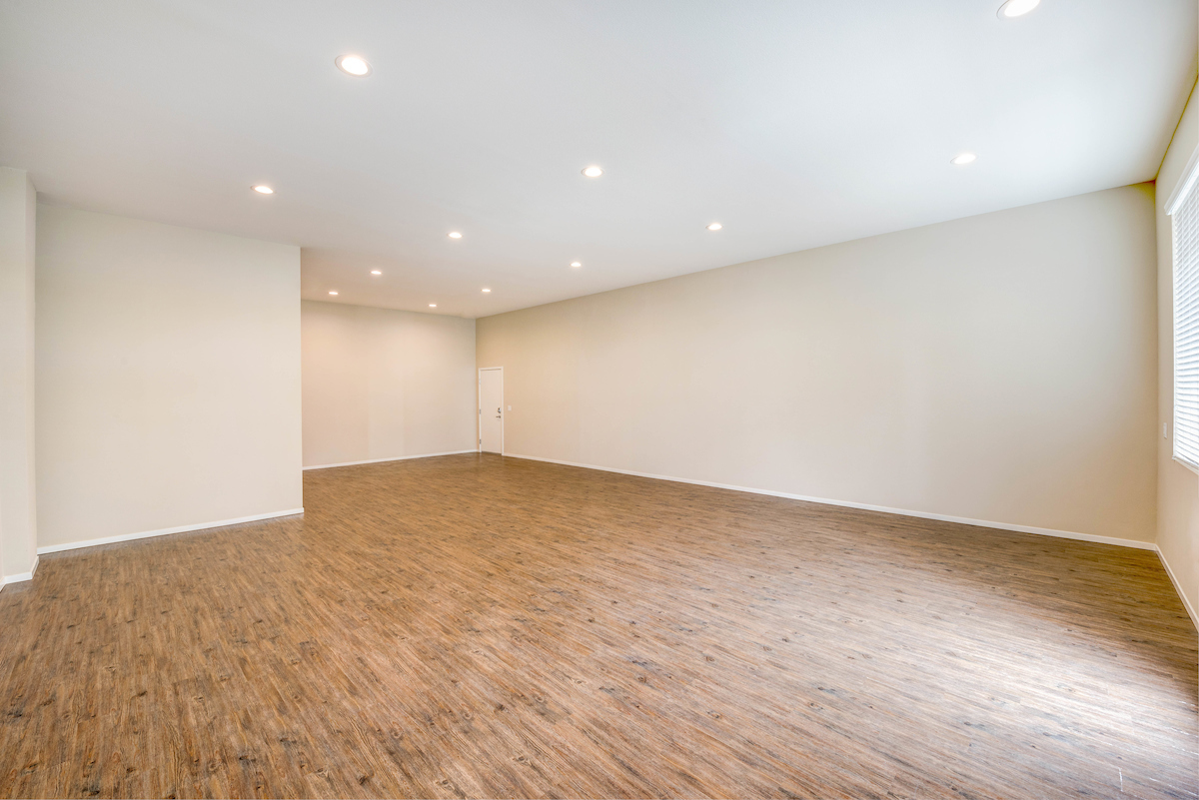
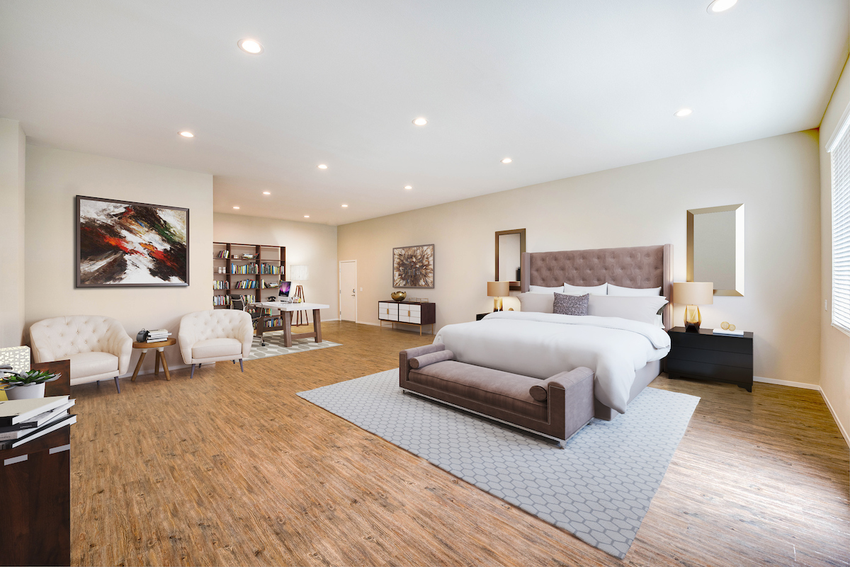
Redevelopment Unit Turns: Advanced Visual Technology
Photography is a key selling opportunity for unit turns
Updated photography is used to advertise your renovations across the website, ILSs, and Craigslist
Additional advanced visual technologies available to you include:
Virtual Tours
Virtual Staging
Video Loops
Email Marketing@essex.com to schedule photography once your mock-up unit is ready
Before
After

Slide 7
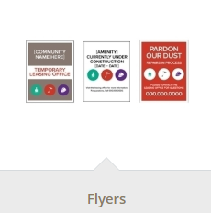
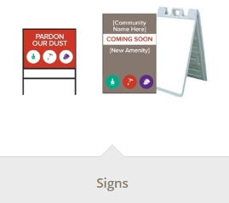
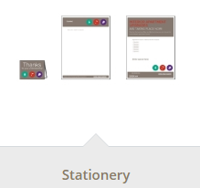
Redevelopment Unit Turns: Collateral – Stationery & Signage
The Home Store offers a variety of temporary signage, stationery, and collateral to help advertise and communicate your project
Process for ordering:
CM places order through The Home Store (Benson)
When checking out, select PO number as the payment method
Enter “Redev” for the PO number

Slide 8
Redevelopment Unit Turns: Resident Events - Open Houses
Open Houses are a great resource to advertise your renovation
Below are some tips to ensure a successful event:
Spread the word
Post flyers and send communications to current residents encouraging them to bring their friends
Request an eBlast from Marketing to be sent to your prospect pipeline at least one week prior to your event
Provide snacks and refreshments for your guests
Using the marketing funds that have been allocated to your redevelopment project, provide snacks and refreshments to keep your guests comfortable and entertained
Consider the timing of your event
Take your target audience’s schedule into consideration when planning your event

Slide 9
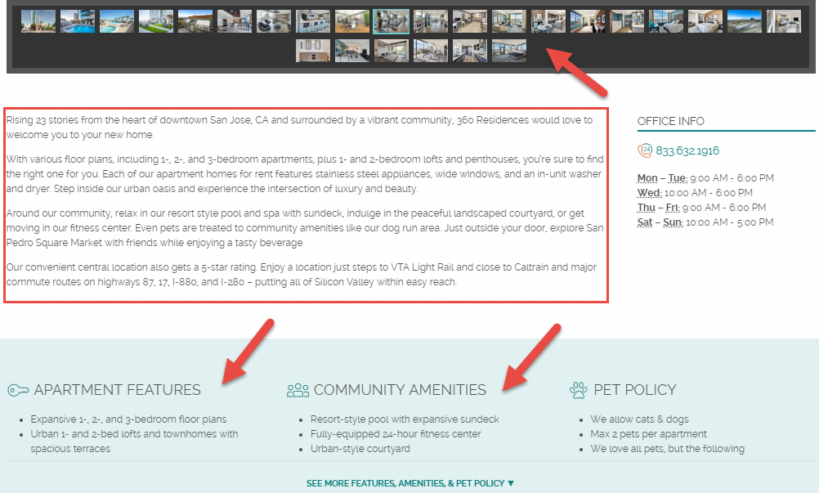
Redevelopment Unit Turns: Website - Content Update
The following areas of the website can be updated to advertise the details of your redevelopment project:
Unit specific, custom features
Amenities list
Community description update
Photography
Email Marketing@essex.com with the details of your project to have your community website updated

