Slide 1
Buyer Training
Designer Name
AMAZON CONFIDENTIAL
Designer Name
Designer Name

Slide 2
Table of Contents
Joining the Amazon Business Account
Shopping on Amazon Business
Business Account Navigation
Your Orders
Checkout
Business Customer Support

Slide 3
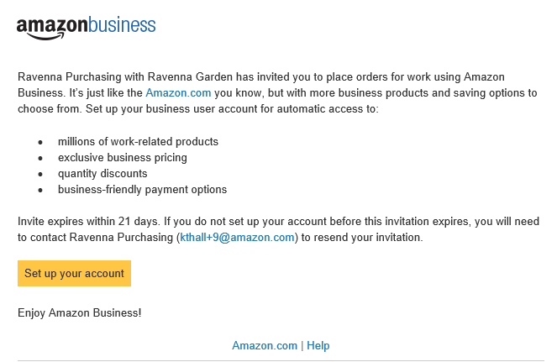
Inviting users to Amazon Business
How do Invitations Work?
When a user is added to the business account, an invitation to join is immediately emailed.
Invitations are tied to an end users email address. The recipient cannot change the email address they use to register for the account.
End users must take action after being invited to an account in order to become an active user.
User permissions are assigned when a user is invited
Account invitations are valid for 21 days from send date. After 21 days, they will expire and need to be resent
DO NOT USE INTERNET EXPLORER
The account admin at your organization
your account admin (email@company.com)

Slide 4
New to Amazon

Slide 5
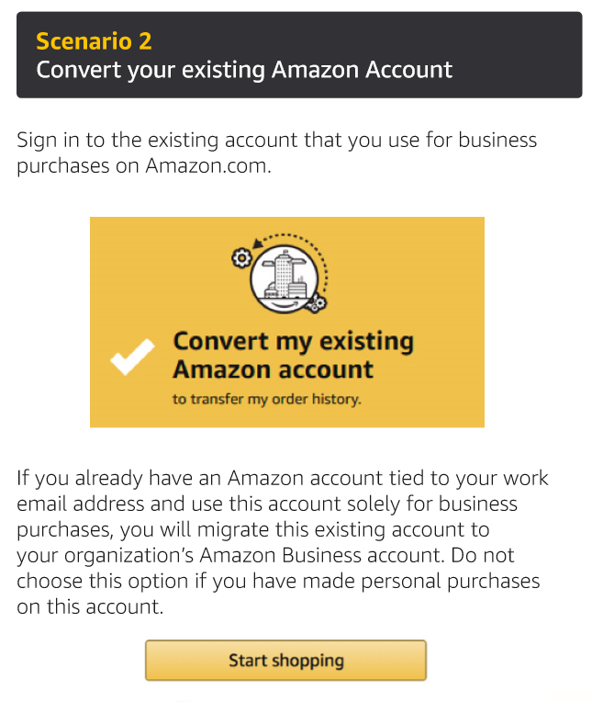
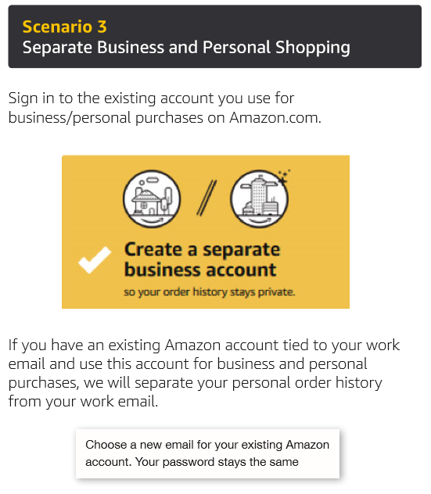
Existing Account with Work Email
OR

Slide 6
Amazon Business Benefits
Business Pricing & Quantity Discounts
Business pricing and quantity discounts are only available to registered business account customers on Amazon. Click to learn more.
Business Prime Shipping
All Essex associates registered to our Amazon account already have access to Free Prime Two-Day Shipping on eligible items for all users in the business account.
Business-Only Selection
Business-only selection refers to items and offers that are only available for purchase by Amazon Business customers.
Amazon Business Analytics
Use Amazon Business Analytics to view data about your orders, create and filter reports based on your business needs, and view both charts and tables. Click to learn more.

Slide 7
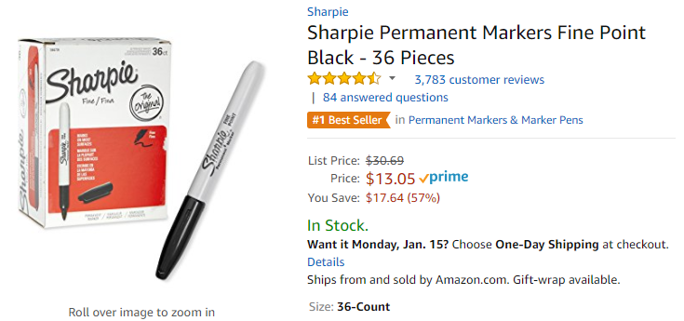
Business P r Shipping
Take Advantage of Amazon Prime Shipping Benefits
An easy way to ensure that your products arrive on time and as expected, is to order products fulfilled directly from Amazon. All products clearly mark who the seller is on the product detail page.
Prime Eligibility – Fulfilled by Amazon
Prime eligible items are fulfilled by Amazon. We recommend searching for prime eligible items.
What’s not Included?
Business Prime Shipping does not include additional Prime benefits such as Amazon Fresh, Pantry, Video, or Music.

Slide 8
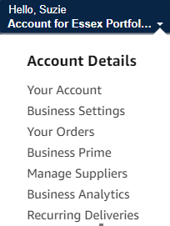
Business Account Navigation
Page | Functionality
Your Account | Standard Amazon account information
Business Settings | Account settings: Addresses, Payment methods, Members, Buying Policies ets. (Admins Only)
Your Orders | View and your track orders. Administrations can view orders others have placed on behalf of the organization
Business Prime | Details of everything included in Business Prime
Manage Suppliers | Easily find suppliers on Amazon Business and add them to your list of Saved Suppliers. Learn more.
Business Analytics | Create and filter custom reports based on your business needs to view your property’s orders
Recurring Deliveries | Have essential items delivered automatically, based on a schedule you choose. Learn More.

Slide 9
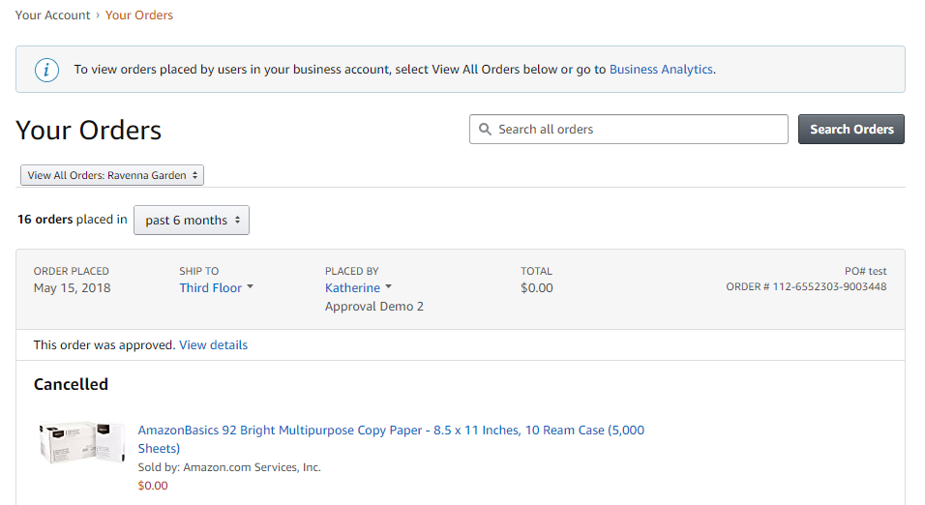
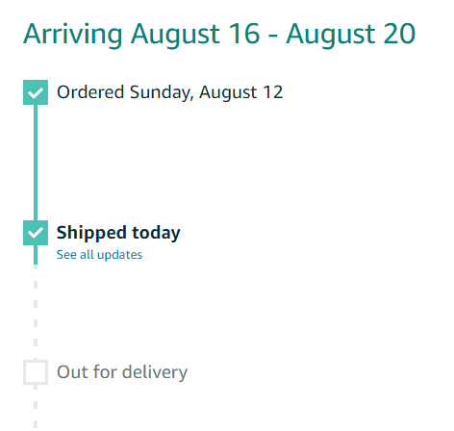
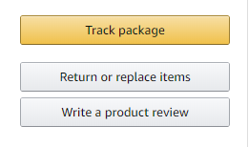
Your Orders
This section of the account provides additional detail regarding the status of all orders placed
Take a variety of actions on your orders such as initiating returns or tracking the delivery of a package.

Slide 10
Checkout – Payment Methods
When checking out on Amazon Business, you will also need to generate a PO for the purchase in Yardi. Before allowing you to check out, Amazon will require you to enter the PO number and name of your property/corporate department. PO numbers are REQUIRED for all community purchases.
***Note: if you are buying on behalf of a corporate department you don’t require a PO. simply list “N/A” in the PO field when checking out.
All purchases made by the communities in Amazon must be done with a PO at the time of checkout.
All purchases made for corporate departments must be done with a P-Card at the time of checkout.
The Amazon Business account is intended for business purchases only.
Payments are visible to your account administrator and can be audited.
Addresses for each community have already been entered into Amazon.
If you are purchasing with a P-Card you will need to enter your own “Ship to” address.
“Ship to” addresses can be edited by your account administrator at any time.
Should specific instructions need to be added to your address please reach out to Procurement@essex.com to enter the appropriate details.

Slide 11
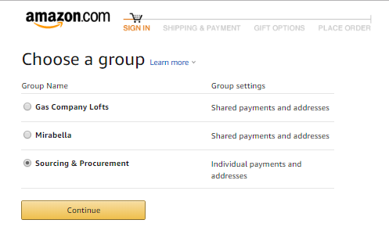
Checkout – Multiple Groups
Individuals who purchase on behalf of multiple communities/departments may be a member of multiple account groups in order to keep reporting organized
End User Experience:
Choose the group you wish to purchase on behalf of during the checkout process. Note: Each cart can only be for one community at a time.
Shipping and payment options may differ depending on the group you have selected during checkout

Slide 12
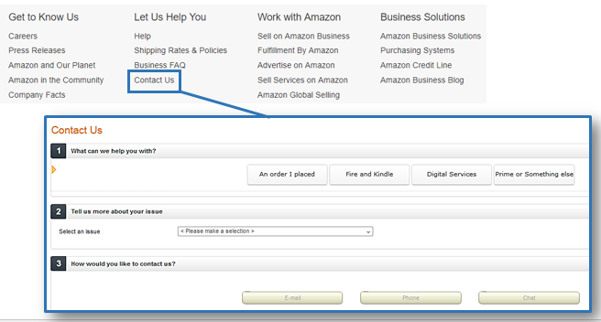
Business Customer Support
Dedicated U.S. based Business Customer Support can be reached a number of ways including email, chat and phone: 888-281-3847 .
Not sure what you’re looking for? Learn more about the features and benefits on Amazon Business HERE.

