Slide 1
Administrator Training
Designer Name
AMAZON CONFIDENTIAL
Designer Name
Designer Name

Slide 2
Table of Contents
Joining the Amazon Business Account
Shopping on Amazon Business
Business Account Navigation
Your Orders
Additional Admin Abilities
Adding new Users
Moving Users to another group
Removing Users from Business Account
Checkout / Payment Methods
Viewing Community Spend
Business Customer Support

Slide 3
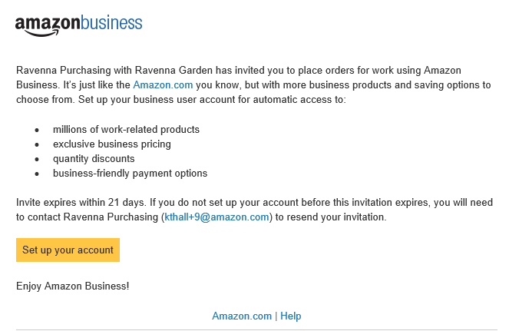
Inviting users to Amazon Business
How do Invitations Work?
When a user is added to the business account, an invitation to join is immediately emailed.
Invitations are tied to an end users email address. The recipient cannot change the email address they use to register for the account.
End users must take action after being invited to an account in order to become an active user.
User permissions are assigned when a user is invited
Account invitations are valid for 21 days from send date. After 21 days, they will expire and need to be resent
DO NOT USE INTERNET EXPLORER
The account admin at your organization
your account admin (email@company.com)

Slide 4
New to Amazon

Slide 5
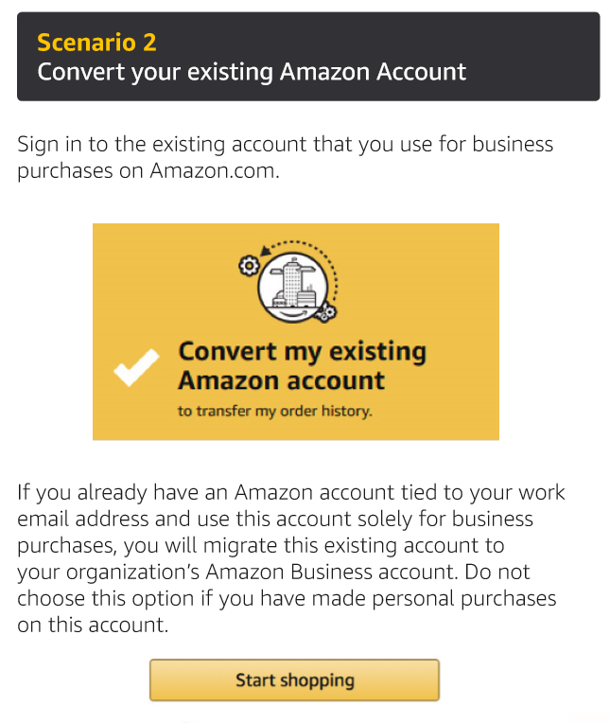
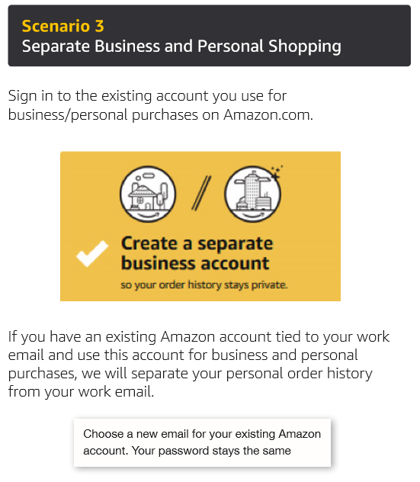
Existing Account with Work Email
OR

Slide 6
Amazon Business Benefits
Business Pricing & Quantity Discounts
Business pricing and quantity discounts are only available to registered business account customers on Amazon. Click to learn more.
Business Prime Shipping
Once Business Prime Shipping has been purchased, it provides Free Two-Day Shipping on eligible items for all users in the business account. There are multiple pricing tiers to meet the needs of businesses of all sizes. Click to learn more.
Buying Policies
Customize Amazon Business to your organization’s buying standards and procedures. Features include approval workflows, negotiated pricing, and preferred suppliers and preferred products.
Business-Only Selection
Business-only selection refers to items and offers that are only available for purchase by Amazon Business customers.
Amazon Business Analytics
Use Amazon Business Analytics to view data about your orders, create and filter reports based on your business needs, and view both charts and tables. Click to learn more.

Slide 7
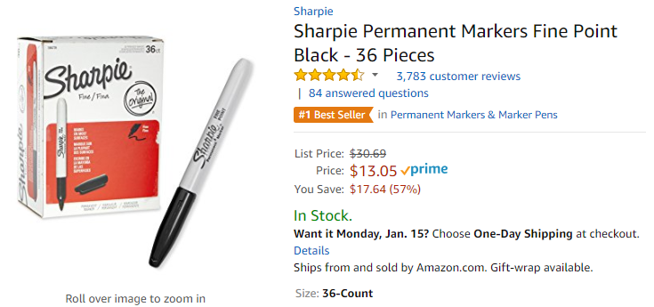
Business P r Shipping
Take Advantage of Amazon Prime Shipping Benefits
An easy way to ensure that your products arrive on time and as expected, is to order products fulfilled directly from Amazon. All products clearly mark who the seller is on the product detail page.
Prime Eligibility – Fulfilled by Amazon
Prime eligible items are fulfilled by Amazon. We recommend searching for prime eligible items.
What’s not Included?
Business Prime Shipping does not include additional Prime benefits such as Amazon Fresh, Pantry, Video, or Music.

Slide 8
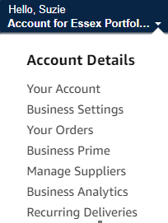
Business Account Navigation
Page | Functionality
Your Account | Standard Amazon account information
Business Settings | Account settings: Addresses, Payment methods, Members, Buying Policies ets. (Admins Only)
Your Orders | View and your track orders. Administrations can view orders others have placed on behalf of the organization
Business Prime | Details of everything included in Business Prime
Manage Suppliers | Easily find suppliers on Amazon Business and add them to your list of Saved Suppliers. Learn more.
Business Analytics | Create and filter custom reports based on your business needs to view your property’s orders
Recurring Deliveries | Have essential items delivered automatically, based on a schedule you choose. Learn More.

Slide 9
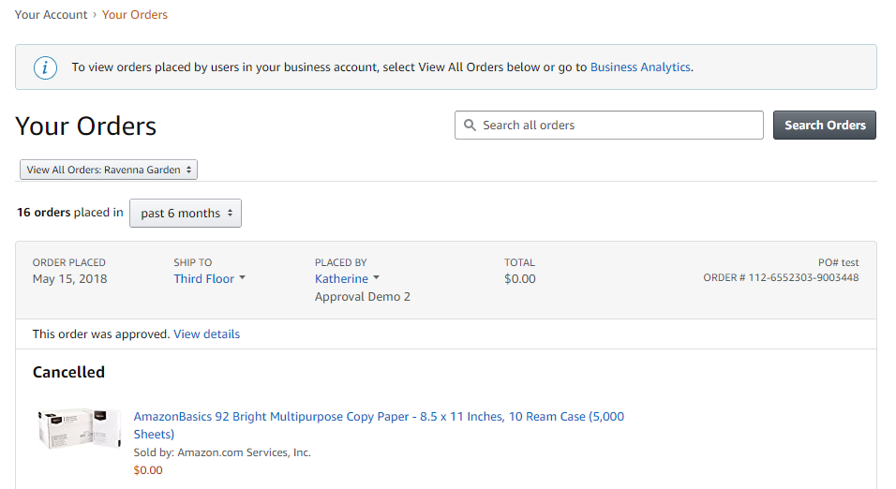
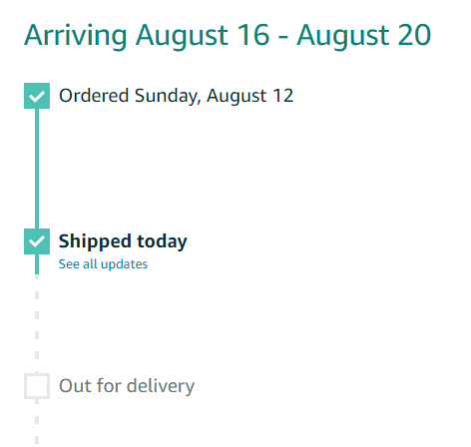
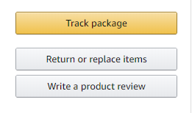
Your Orders
This section of the account provides additional detail regarding the status of all orders placed
Take a variety of actions on your orders such as initiating returns or tracking the delivery of a package.

Slide 10
Additional Admin Abilities

Slide 11
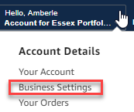
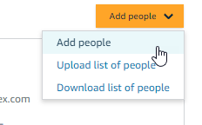
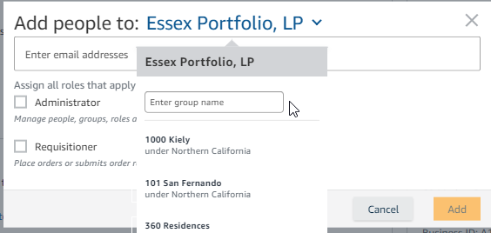
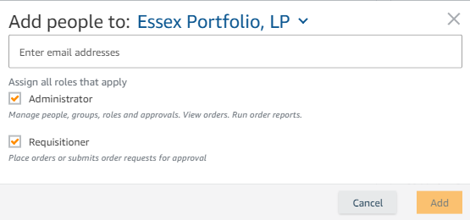
Inviting new users to Amazon Business
How do I invite a new user to the account
Hover over your name in the upper right hand corner and select “Business Settings” from the drop down.
Click on the orange “Add People” button, from the drop down click “Add People”.
In the new window first ensure that the appropriate group is selected, you can change the group from the drop down if you are assigned to multiple groups.
Enter in the appropriate Essex email address and select the new user’s role. Note: Administrators should only be RPM’s and their assistants. CM’s & MS’s and other corporate purchasers should be marked as Requisitioner.
Click “Add”
2
1
3
Select the group you are adding to. Only those you belong to will appear.
Select only Requisitioner unless you are adding an RPM or RPM Assistant
4
5

Slide 12
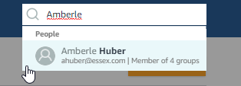
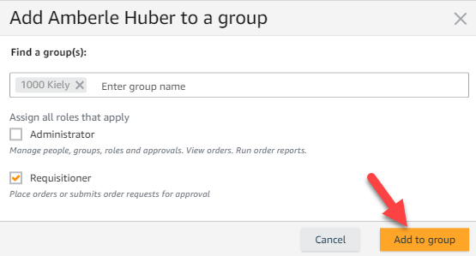
Moving Users to Another Group
Due to the level of turnover with our communities it is to be expected that some associates may move to a new property. Amazon makes it easy to give each associate the proper access they require:
Navigate to the “Business Settings” page, from the dropdown menu below your name.
In the search bar type in the appropriate associates name (be sure it’s the smaller search bar just above the “Add People” button).
After clicking on the associates name you’ll be directed to a new page that lists the current groups they have access to. Click “Add to another Group”
Enter the appropriate group name(s) and select the appropriate role.
Click “Add to Group”
1
3
2
4
5

Slide 13
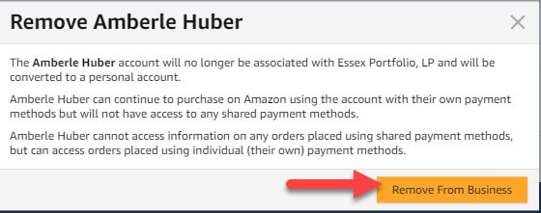
Removing Users from Business Account
Amazon makes it simple to remove users from groups as well.
Note: If the user is still working with Essex, be sure you have added the new communities first before removing from the old, or the users account may be deleted.
Follow the first 2 steps from the previous slide to locate the appropriate user.
After clicking on the associates name you’ll be directed to a new page that lists the current groups they have access to. Locate the group name that they no longer should utilize; click on “Actions” -> “Remove From Group”
To Remove a user from our Business Account:
In the event that someone is no longer with the company you can remove their access completely.
Click on the “Remove from Business” button
A final alert will appear, to continue click “Remove from Business” once more
3
4
5

Slide 14
Checkout – Payment Methods
Before allowing you to check out, Amazon will require you to enter the PO number and name of your property/corporate department. All admins should simply list “N/A” in the PO Required Box.
Purchases made for your personal business needs should be done through your regional group and will be paid with your P-card.
All purchases made by or for the communities in Amazon must be done with a PO at the time of checkout.
All purchases made for corporate departments must be done with a P-Card at the time of checkout.
The Amazon Business account is intended for business purchases only.
Payments are visible to your account administrator and can be audited.
Addresses for each community have already been entered into Amazon.
If you are purchasing with a P-Card you will need to enter your own “Ship to” address.
“Ship to” addresses can be edited by your account administrator at any time.
Should specific instructions need to be added to your address please reach out to Procurement@essex.com to enter the appropriate details.

Slide 15
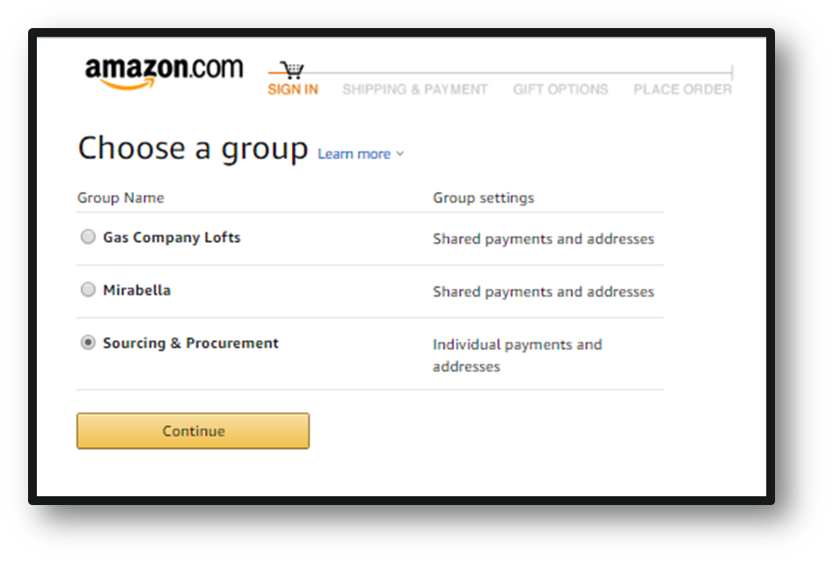
Checkout – Multiple Groups
Individuals who purchase on behalf of multiple departments may be a member of multiple account groups in order to keep reporting organized
End User Experience:
Choose the group you wish to purchase on behalf of during the checkout process
Shipping and payment options may differ depending on the group you have selected during checkout

Slide 16
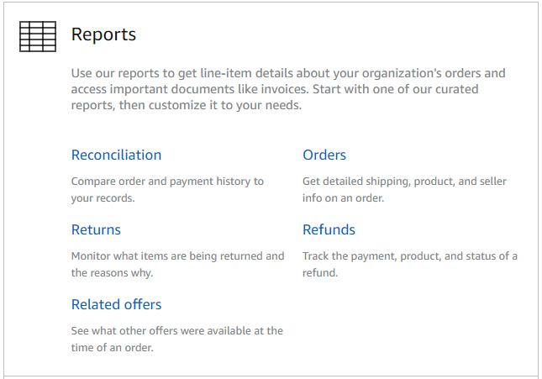
Amazon Business Analytics
Amazon Business Analytics provides the ability to:
Aggregate purchases to compare and track spend over time
Monitor and track 60+ data fields including customer info, shipment info, payment info, and seller info
Customize and save report templates to meet business needs
Download CSV files to analyze your data in excel

Slide 17
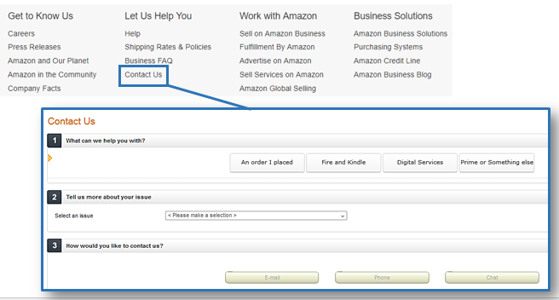
Business Customer Support
Dedicated U.S. based Business Customer Support can be reached a number of ways including email, chat and phone.
Not sure what you’re looking for? Learn more about the features and benefits on Amazon Business HERE.

